Slide 1
Street Dance
LEARNING OBJECTIVES:
To be able to perform a technical routine
To understand how to perform them safely
To be able to learn new material and rehearse previously learnt material
To be able to complete a log sheet in detail

Slide 2
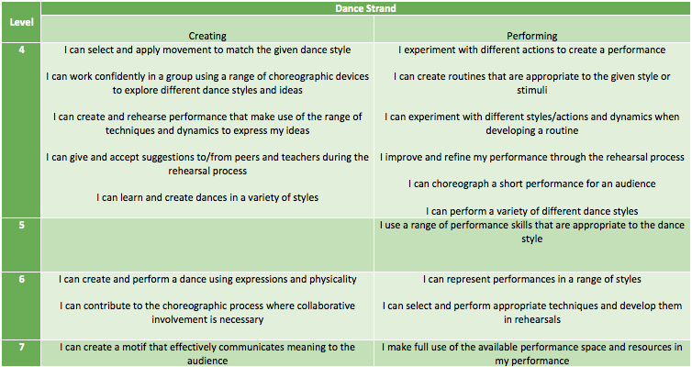
Success Criteria

Slide 3
Warm up GROUP 2 TO LEAD THIS WEEKS WARM UP.

Slide 4
Safety when performing technical moves
1. Always warm up before you attempt a move
Why do we do this?

Slide 5
Safety when performing technical moves
2. Always build up to a move
Why should we never just ‘go’ for a movement we’ve seen someone else do?

Slide 6
Safety when performing technical moves
3. Look around you!
What hazards could there be that could put you or someone else in danger?

Slide 7
Lets Dance!
Recap last weeks choreography
Learn new material
Cool down
Log sheets

Slide 8
CREATIVITY
Recap the movement material you created last week in your small groups, which should include.
The Jerk
The Dougie
The Uprock
Now choreograph the next section of your dance using:
JUMPS
TRAVELLING
TURNS
FREEZES
REHEARSE ALL OF THE MOVEMENT JOINED TOGETHER.

Slide 9
Plenary
What have you enjoyed?
What have you found challenging?
What have you learnt?
How have you progressed?
What can you improve on next time?
Well done!

